Slide 1
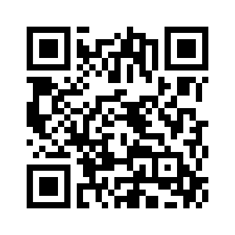
Sensor Fusion
COMSM4111 Robotic Systems
Anonymous Feedback form:
https://forms.gle/PyQQy2mwzyATFmJW6
Padlet board (questions & comments):
http://padlet.com/paul_odowd1/1lhoodwv2fuc
Delivered by:
Martin Garrad m.garrad@bristol.ac.uk
Notes:
This lecture is all about Time

Slide 2
Lab Sessions / Sheets
Week 1
Week 2
Week 3
Week 4
Week 5
Week 6
Week 7
Meet the Romi
Millis()
Encoders
PID
Line Following
Finite State Machine
Motors
Time & Speed
Kinematics
Lectures
Intro
Sensors & Actuators
Feedback Control 2
Probabilistic Robotics
System
Architectures
Path Planning
Experimental Robotics
Micro-controllers
Feedback Control 1
PID Drop-In
A
Kinematics
Sensor Fusion
Searching & Mapping
Toward
Assessment 2
Assessment Op 1
Assessment Op 2
Assessment Op 3

Slide 3
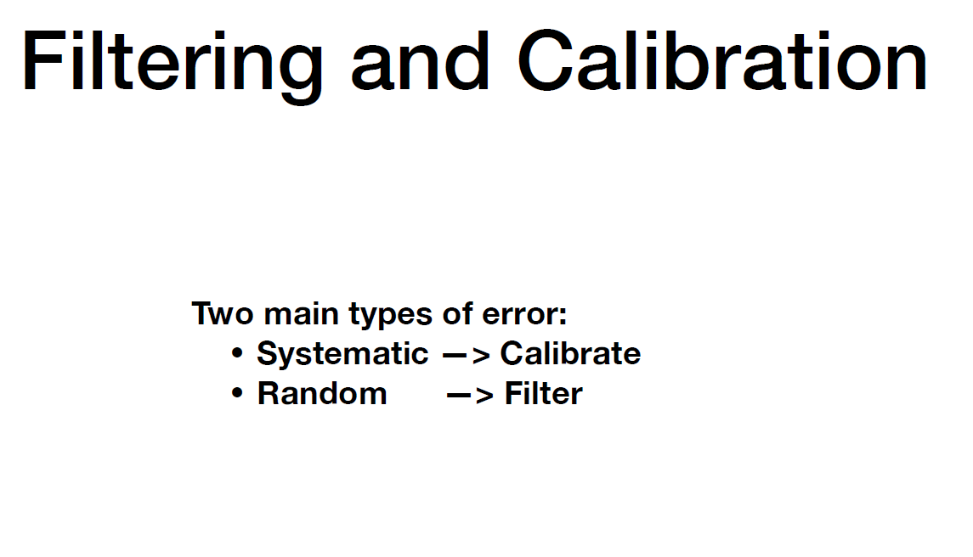

Slide 4
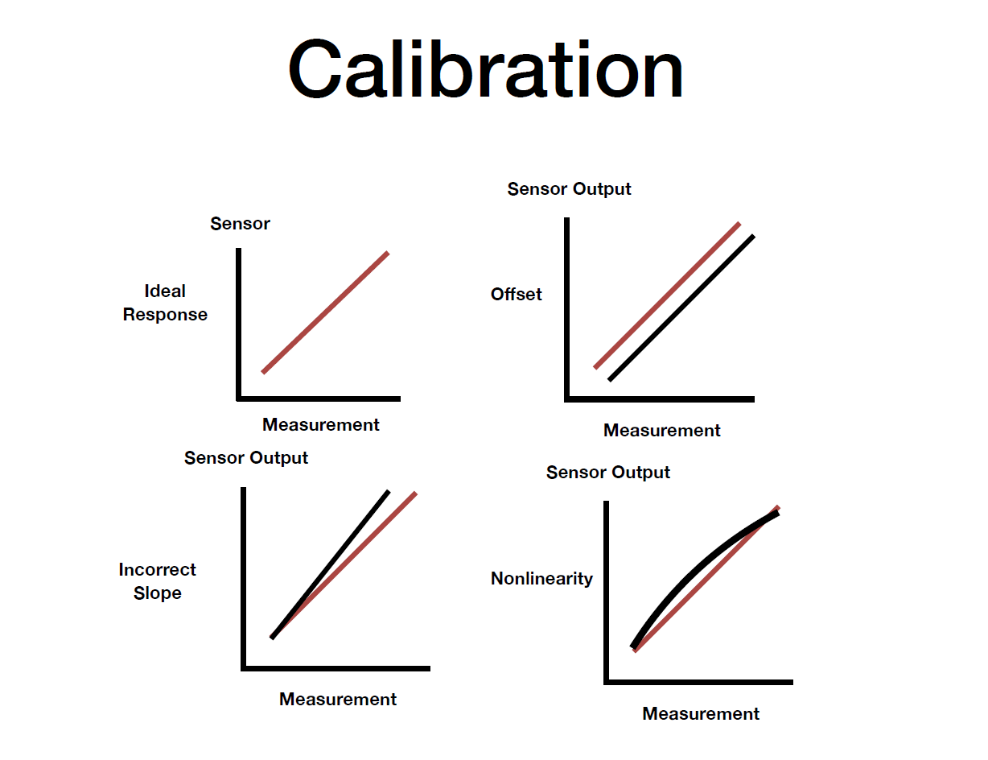

Slide 5
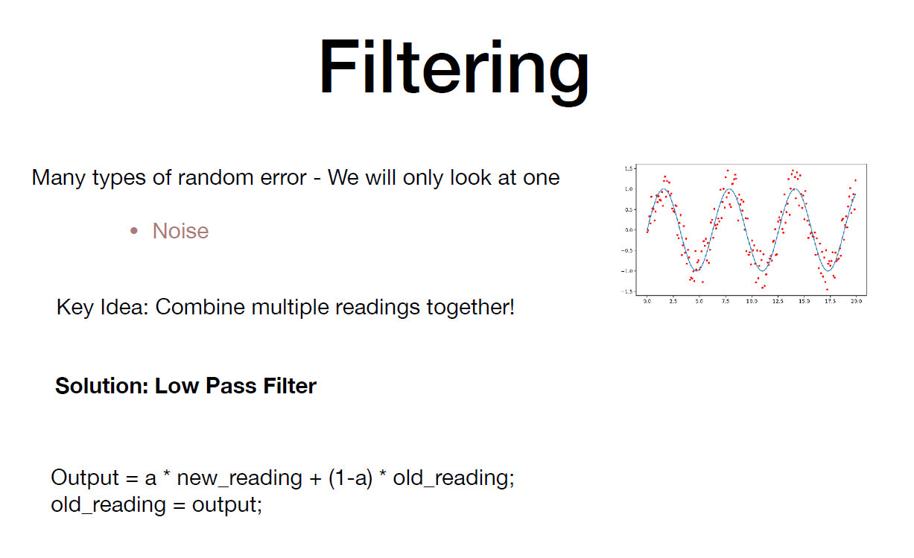

Slide 6
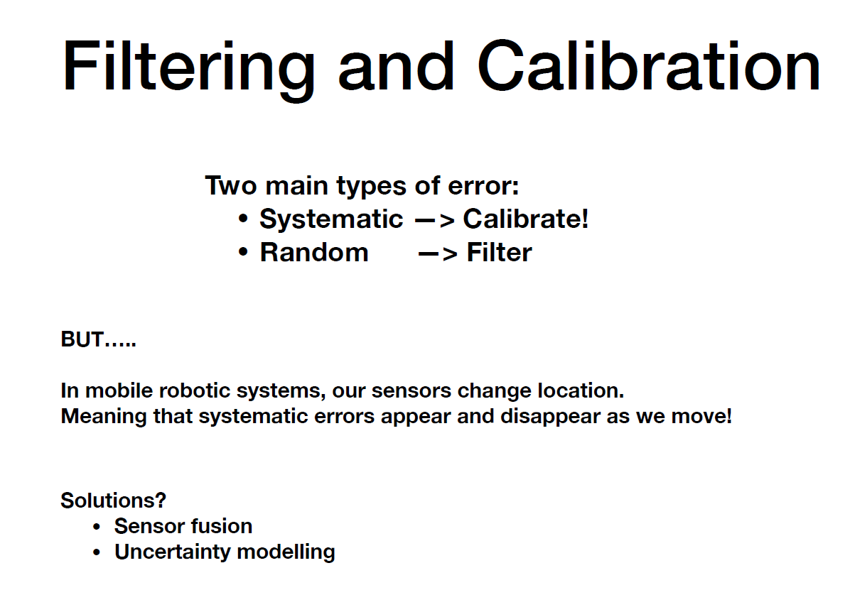

Slide 7
Outline
Bayesian Updating
Sensor Fusion
Practical example

Slide 8
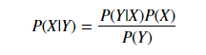
Bayesian Updating
Likelihood
Prior
Posterior
Evidence

Slide 9
Bayesian Updating
Likelihood
Prior
Posterior
Evidence
Bayes Rule lets us infer x from y
i.e We can infer our position (x) from our sensor data (y)
Bayes Rule also lets us integrate information over time
as the posterior at time t becomes the prior at t+1

Slide 10
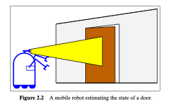
Bayesian Updating
The robot takes a measurement (z)
What is P(open | z) ?

Slide 11
Bayesian Updating
The robot takes a measurement (z)
What is P(open | z) ?
P(open | z) = P( z | open) P(open) / P(z)

Slide 12
Bayesian Updating
Prior: P_open = 0.5, P_closed = 0.5
Assume sensor only gives two readings
P(Z1 | Open) = 0.8
P(Z2 | Open) = 0.2
P(Z1 | Closed) = 0.3
P(Z2 | Closed) = 0.7
The robot takes a measurement (z)
What is P(open | z) ?
P(open | z) = P( z | open) P(open) / P(z)

Slide 13
Bayesian Updating
Prior: P_open = 0.5 , P_closed = 0.5
Assume sensor only gives two readings
P(Z1 | Open) = 0.8
P(Z2 | Open) = 0.2
P(Z1 | Closed) = 0.3
P(Z2 | Closed) = 0.7
We take a reading and get Z1.
The robot takes a measurement (z)
What is P(open | z) ?
P(open | z) = P( z | open) P(open) / P(z)

Slide 14
Bayesian Updating
Prior: P_open = 0.5 , P_closed = 0.5
Assume sensor only gives two readings
P(Z1 | Open) = 0.8
P(Z2 | Open) = 0.2
P(Z1 | Closed) = 0.3
P(Z2 | Closed) = 0.7
We take a reading and get Z1.
P(Open | Z1) = P(Z1 | Open) * P(Open)
= 0.8 *0.5 = 0.4
P(Closed | Z1) = P(Z1 | Closed) * P(Closed)
= 0.3 * 0.5 = 0.15
The robot takes a measurement (z)
What is P(open | z) ?
P(open | z) = P( z | open) P(open) / P(z)

Slide 15
Bayesian Updating
Prior: P_open = 0.5 , P_closed = 0.5
Assume sensor only gives two readings
P(Z1 | Open) = 0.8
P(Z2 | Open) = 0.2
P(Z1 | Closed) = 0.3
P(Z2 | Closed) = 0.7
We take a reading and get Z1.
P(Open | Z1) = P(Z1 | Open) * P(Open)
= 0.8 *0.5 = 0.4
P(Closed | Z1) = P(Z1 | Closed) * P(Closed)
= 0.3 * 0.5 = 0.15
After normalising, P(Open) = 0.73
P(Closed) = 0.27
The robot takes a measurement (z)
What is P(open | z) ?
P(open | z) = P( z | open) P(open) / P(z)

Slide 16
Bayesian Updating
Prior: P_open = 0.5 , P_closed = 0.5
Assume sensor only gives two readings
P(Z1 | Open) = 0.8
P(Z2 | Open) = 0.2
P(Z1 | Closed) = 0.3
P(Z2 | Closed) = 0.7
We take a reading and get Z1.
P(Open | Z1) = P(Z1 | Open) * P(Open)
= 0.8 *0.5 = 0.4
P(Closed | Z1) = P(Z1 | Closed) * P(Closed)
= 0.3 * 0.5 = 0.15
After normalising, P(Open) = 0.73
P(Closed) = 0.27
We take a second reading and get Z1.
The robot takes a measurement (z)
What is P(open | z) ?
P(open | z) = P( z | open) P(open) / P(z)

Slide 17
Bayesian Updating
Prior: P_open = 0.5 , P_closed = 0.5
Assume sensor only gives two readings
P(Z1 | Open) = 0.8
P(Z2 | Open) = 0.2
P(Z1 | Closed) = 0.3
P(Z2 | Closed) = 0.7
We take a reading and get Z1.
P(Open | Z1) = P(Z1 | Open) * P(Open)
= 0.8 *0.5 = 0.4
P(Closed | Z1) = P(Z1 | Closed) * P(Closed)
= 0.3 * 0.5 = 0.15
After normalising, P(Open) = 0.73
P(Closed) = 0.27
We take a second reading and get Z1.
P(Open | Z1) = P(Z1 | Open) * P(Open)
= 0.8 *0.73 = 0.58
P(Closed | Z1) = P(Z1 | Closed) * P(Closed)
= 0.3 * 0.27 = 0.081
The robot takes a measurement (z)
What is P(open | z) ?
P(open | z) = P( z | open) P(open) / P(z)

Slide 18
Bayesian Updating
Prior: P_open = 0.5 , P_closed = 0.5
Assume sensor only gives two readings
P(Z1 | Open) = 0.8
P(Z2 | Open) = 0.2
P(Z1 | Closed) = 0.3
P(Z2 | Closed) = 0.7
We take a reading and get Z1.
P(Open | Z1) = P(Z1 | Open) * P(Open)
= 0.8 *0.5 = 0.4
P(Closed | Z1) = P(Z1 | Closed) * P(Closed)
= 0.3 * 0.5 = 0.15
After normalising, P(Open) = 0.73
P(Closed) = 0.27
We take a second reading and get Z1.
P(Open | Z1) = P(Z1 | Open) * P(Open)
= 0.8 *0.73 = 0.58
P(Closed | Z1) = P(Z1 | Closed) * P(Closed)
= 0.3 * 0.27 = 0.081
After normalising, P(Open) = 0.88
P(Closed) = 0.12
The robot takes a measurement (z)
What is P(open | z) ?
P(open | z) = P( z | open) P(open) / P(z)

Slide 19
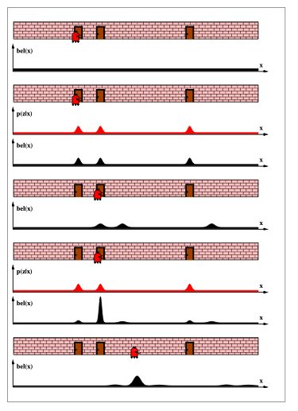
Bayesian Updating

Slide 20
Bayesian Updating

Slide 21
Bayesian Updating

Slide 22
Bayesian Updating

Slide 23
Bayesian Updating

Slide 24
Bayesian Updating

Slide 25
Outline
Bayesian Updating
Sensor Fusion
Practical example

Slide 26
Sensor Fusion Intuition
Key Idea 1: Sensors are unreliable (and should not be trusted)

Slide 27
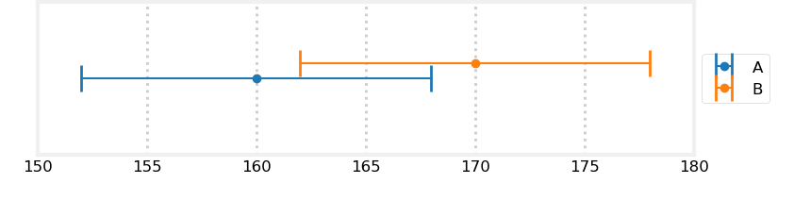
Sensor Fusion Intuition

Slide 28
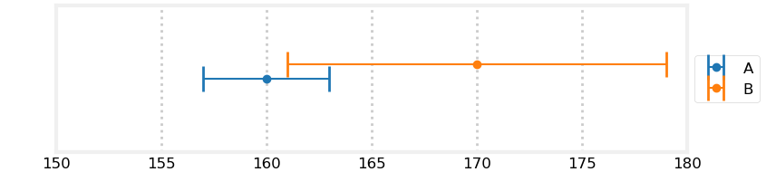
Sensor Fusion Intuition

Slide 29
Sensor Fusion Intuition
Key Idea 1: Sensors are unreliable (and should not be trusted)
Key Idea 2: Combine multiple sensors to get a better estimate of our measured quantity

Slide 30
Sensor Fusion Intuition
Key Idea 1: Sensors are unreliable (and should not be trusted)
Key Idea 2: Combine multiple sensors to get a better estimate of our measured quantity
Don’t throw away information

Slide 31
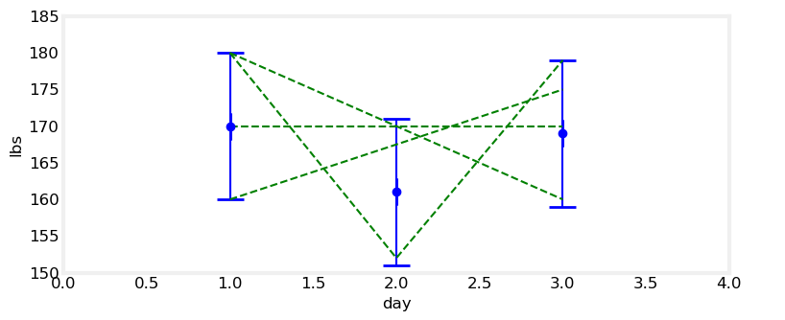
Sensor Fusion Intuition

Slide 32
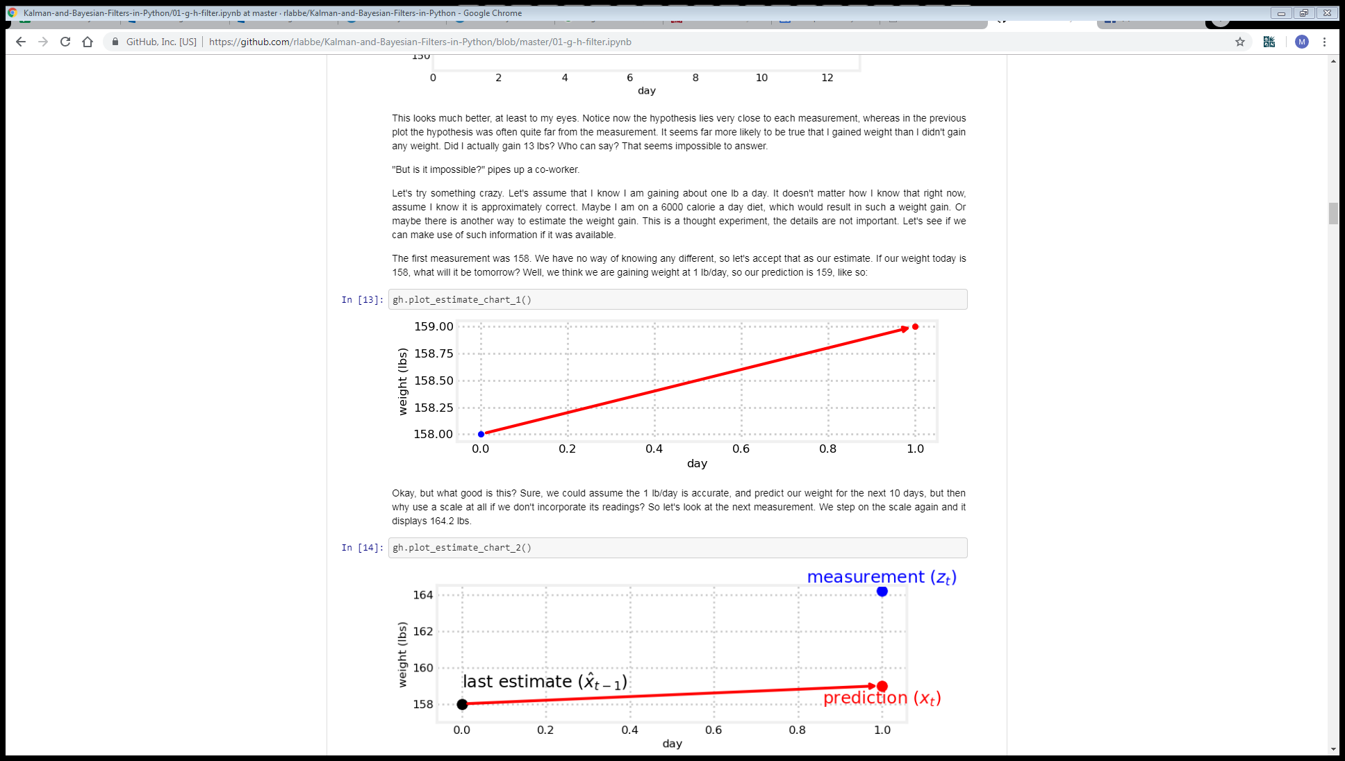
Sensor Fusion Intuition
Prediction = estimate + gain

Slide 33
Sensors Fusion Intuition
Prediction = estimate + gain

Slide 34
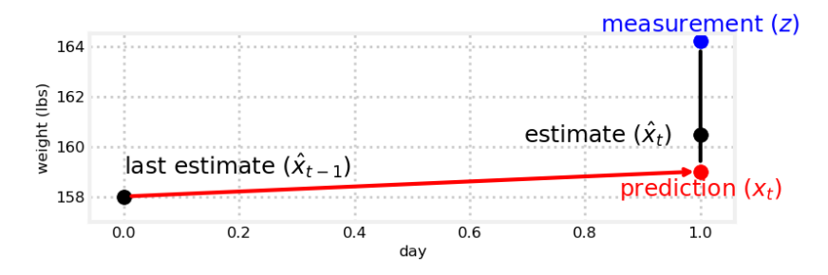
Sensors Fusion Intuition
Prediction = estimate + gain

Slide 35
Sensors Fusion Intuition
Prediction = estimate + gain
New_Estimate = prediction + weight x (measurement – prediction)

Slide 36
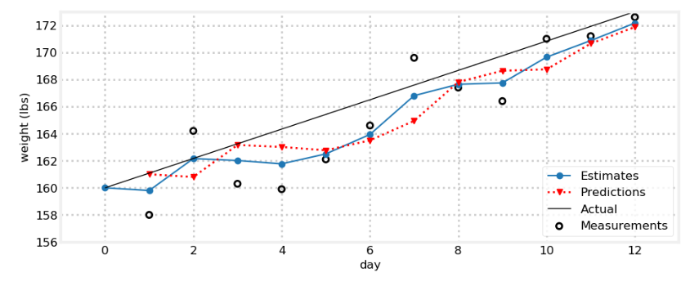
Sensors Fusion Intuition
Gain = 1
Prediction = estimate + gain
New_Estimate = prediction + weight x (measurement – prediction)

Slide 37
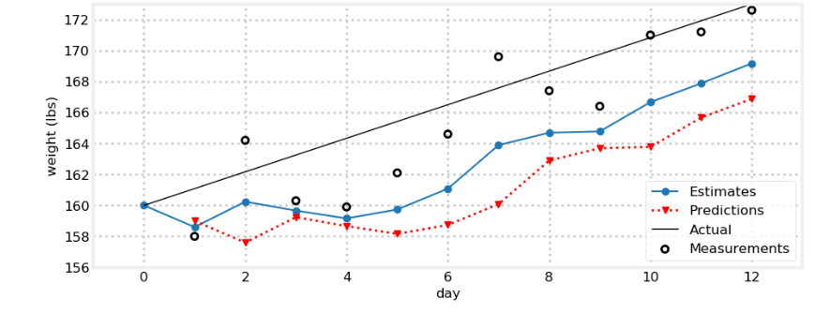
Sensors Fusion Intuition
Gain = -1
Prediction = estimate + gain
New_Estimate = prediction + weight x (measurement – prediction)

Slide 38
Sensors Fusion Intuition
Q: Can we estimate the gain from past measurements?

Slide 39
Sensors Fusion Intuition
New Gain = old gain + weight_1 x (measurement – prediction) / time
Prediction = estimate + gain
New_Estimate = prediction + weight_2 x (measurement – prediction)

Slide 40
Sensors Fusion Intuition
New Gain = old gain + h x (measurement – prediction) / time
Prediction = estimate + gain
New_Estimate = prediction + g x (measurement – prediction)

Slide 41
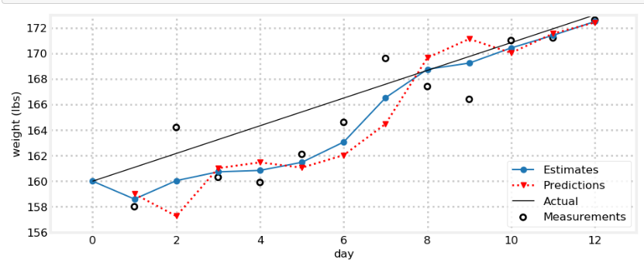
Sensors Fusion Intuition

Slide 42
Sensors Fusion Intuition
Key Idea 1: Sensors are unreliable (and should not be trusted).
Key Idea 2: Combine multiple sensors to get a better estimate of our measured quantity.
Don’t throw away information.
Key Idea 3: Incorporate prior knowledge
Prior beliefs about our estimate
Prior beliefs about the dynamics of our estimate

Slide 43
Outline
Bayesian Updating
Sensor Fusion
Practical example

Slide 44
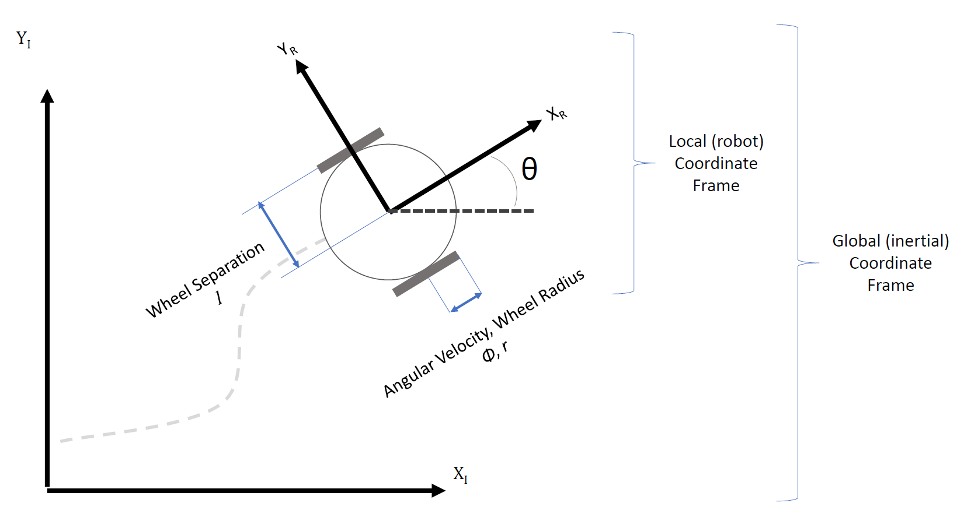
A specific problem: heading estimation

Slide 45
A specific problem: heading estimation
Possible sources of heading information?

Slide 46
A specific problem: heading estimation
Possible sources of heading information?
Encoders (via Kinematics)

Slide 47
A specific problem: heading estimation
Possible sources of heading information?
Encoders (via Kinematics)
Magnetometer (via some trigonometry)

Slide 48
A specific problem: heading estimation
Possible sources of heading information?
Encoders (via Kinematics)
Magnetometer (via some trigonometry)
Gyroscope (via Integration)

Slide 49
A specific problem: heading estimation
Possible sources of heading information?
Encoders (via Kinematics)
Magnetometer (via some trigonometry)
Gyroscope (via Integration)
Accelerometer (via double integration)

Slide 50
A specific problem: heading estimation
Possible sources of heading information?
Encoders (via Kinematics)
Magnetometer (via some trigonometry)
Gyroscope (via Integration)
Accelerometer (via double integration)

Slide 51
A specific problem: heading estimation
Q: How do we get heading from the magnetometer?

Slide 52
A specific problem: heading estimation
Q: How do we get heading from the magnetometer?
A: atan2(mY, mX)

Slide 53
A specific problem: heading estimation
Q: How do we get heading from the gyroscope?
A: Integrate
Angle = angle + gyro * dt

Slide 54
A specific problem: heading estimation
Q: Can we combine these sources?

Slide 55
A specific problem: heading estimation
Q: Can we combine these sources?
A: Yes! (With a complementary filter)

Slide 56
A specific problem: heading estimation
Q: Can we combine these sources?
A: Yes! (With a complementary filter)
heading_complementary = alpha * (heading_complementary + ((gyro_reading) * elapsed_time)) + ((1-alpha) * heading_filter_mag);

Slide 57
A specific problem: heading estimation
Q: Can we integrate the encoders too?
A: Yes! (With the g-h filter)
Use the kinematics as the “prediction” and complementary filter output as the measurement

